Slide 1

Java and its Evolution

Slide 2
Contents
Java Introduction
Java Features
How Java Differs from other OO languages
Java and the World Wide Web
Java Environment
Build your first Java Program
Summary and Reference

Slide 3
Java - An Introduction
Java - The new programming language developed by Sun Microsystems in 1991.
Originally called Oak by James Gosling, one of the inventors of the Java Language.
Java -The name that survived a patent search
Java Authors: James , Arthur Van , and others
Java is really “C++ -- ++ “

Slide 4
Java Introduction
Originally created for consumer electronics (TV, VCR, Freeze, Washing Machine, Mobile Phone).
Java - CPU Independent language
Internet and Web was just emerging, so Sun turned it into a language of Internet Programming.
It allows you to publish a webpage with Java code in it.

Slide 5
Java Milestones
Year | Development
1990 | Sun decided to developed special software that could be used for electronic devices. A project called Green Project created and head by James Gosling.
1991 | Explored possibility of using C++, with some updates announced a new language named “Oak”
1992 | The team demonstrated the application of their new language to control a list of home appliances using a hand held device.
1993 | The World Wide Web appeared on the Internet and transformed the text-based interface to a graphical rich environment. The team developed Web applets (time programs) that could run on all types of computers connected to the Internet.

Slide 6
Java Milestones
Year | Development
1994 | The team developed a new Web browsed called “Hot Java” to locate and run Applets. HotJava gained instance success.
1995 | Oak was renamed to Java, as it did not survive “legal” registration. Many companies such as Netscape and Microsoft announced their support for Java
1996 | Java established itself it self as both 1. “the language for Internet programming” 2. a general purpose OO language.
1997- | A class libraries, Community effort and standardization, Enterprise Java, Clustering, etc..

Slide 7
Sun white paper defines Java as:
Simple and Powerful
Safe
Object Oriented
Robust
Architecture Neutral and Portable
Interpreted and High Performance
Threaded
Dynamic

Slide 8
Java Attributes
Familiar, Simple, Small
Compiled and Interpreted
Platform-Independent and Portable
Object-Oriented
Robust and Secure
Distributed
Multithreaded and Interactive
High Performance
Dynamic and Extensible

Slide 9
Java is Compiled and Interpreted
Programmer
Hardware and
Operating System
Source Code
Byte Code
Text Editor
Compiler
Interpreter
.java file
.class file
Notepad, emacs,vi
javac
java
appletviewer
netscape

Slide 10
Compiled Languages
Programmer
Source Code
Object Code
Executable Code
Text Editor
Compiler
linker
.c file
.o file
a.out file
Notepad, emacs,vi
gcc

Slide 11
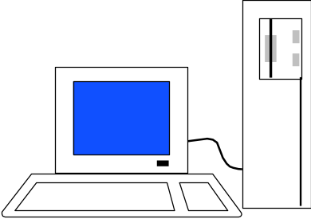
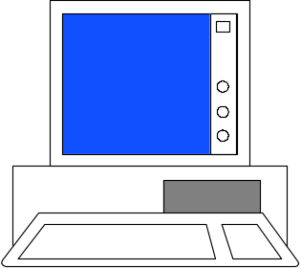
Total Platform Independence
JAVA COMPILER
(translator)
JAVA BYTE CODE
(same for all platforms)
JAVA INTERPRETER
(one for each different system)
Windows 95
Macintosh
Solaris
Windows NT

Slide 12
Architecture Neutral & Portable
Java Compiler - Java source code (file with extension .java) to bytecode (file with extension .class)
Bytecode - an intermediate form, closer to machine representation
A interpreter (virtual machine) on any target platform interprets the bytecode.

Slide 13
Architecture Neutral & Portable
Porting the java system to any new platform involves writing an interpreter.
The interpreter will figure out what the equivalent machine dependent code to run

Slide 14

Rich Class Environment
Core Classes
  language
  Utilities
  Input/Output
  Low-Level Networking
  Abstract Graphical User Interface
Internet Classes
  TCP/IP Networking
  WWW and HTML
  Distributed Programs

Slide 15
How Does Java Compares to C++ and Other OO Languages

Slide 16
Overlap of C, C++, and Java
C++
C
Java

Slide 17
Java better than C++ ?
No Typedefs, Defines, or Preprocessor
No Global Variables
No Goto statements
No Pointers
No Unsafe Structures
No Multiple Inheritance
No Operator Overloading
No Automatic Coercions
No Fragile Data Types
?

Slide 18
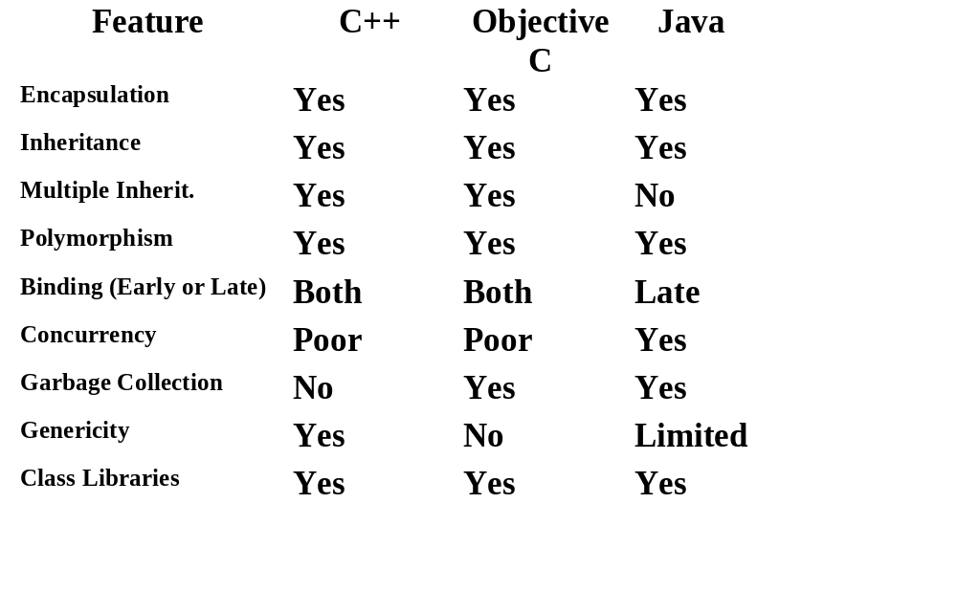
Object Oriented Languages -A Comparison

Slide 19
Java Integrates
Power of Compiled Languages
and
Flexibility of Interpreted Languages

Slide 20
Java Applications
We can develop two types of Java programs:
  Stand-alone applications
  Web applications (applets)

Slide 21
Applications v/s Applets
Different ways to run a Java executable are:
  Application- A stand-alone program that can be invoked from command line . A program that has a “main” method
  Applet- A program embedded in a web page , to be run when the page is browsed . A program that contains no “main” method

Slide 22
Applets v/s Applications
Different ways to run a Java executable are
  Application- A stand-alone program that can be invoked from command line . A program that has a “main” method
  Applet- A program embedded in a web page , to be run when the page is browsed . A program that contains no “main” method
Application –Executed by the Java interpreter.
Applet- Java enabled web browser.

Slide 23
Java and World Wide Web
Turning the Web into an Interactive and Application Delivery Platform

Slide 24
What is World Wide Web ?
Web is an open-ended information retrieval system designed to be used in the Internet wide distributed system.
It contains Web pages (created using HTML) that provide both information and controls.
Unlike a menu driven system--where we are guided through a particular direction using a decision tree, the web system is open ended and we can navigate to a new document in any direction.

Slide 25
Web Structure of Information Search/Navigation

Slide 26
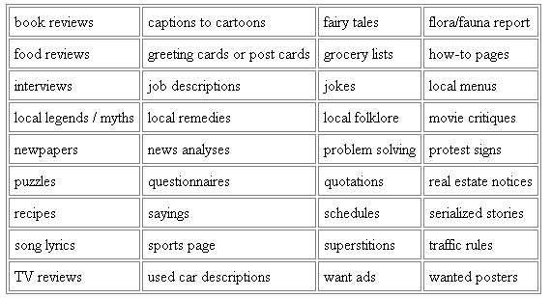
Web as a delivery Vehicle

Slide 27


Execution of Applets
1
2
3
4
5
APPLET Development “hello.java”
AT
SUN.COM
hello.class
AT SUN’S
WEB SERVER
Create Applet
tag in HTML
document
Accessing
from
Unimelb.edu.au
The browser creates
a new window and
a new thread and
then runs the code
Hello Java
<app=
“Hello”>
The Internet
Hello

Slide 28
Significance of downloading Applets
Interactive WWW
Flashy animation instead of static web pages
Applets react to users input and dynamically change
Display of dynamic data
WWW with Java - more than a document publishing medium
http://www.javasoft.com/applets/alpha/applets/StockDemo/standalone.html

Slide 29
Power of Java and the Web
Deliver applications, not just information
Eliminate porting
Eliminate end-user installation
Slash software distribution costs
Reach millions of customers - instantly

Slide 30

Java Development Kit
javac - The Java Compiler
java - The Java Interpreter
jdb- The Java Debugger
appletviewer -Tool to run the applets
javap - to print the Java bytecodes
javaprof - Java profiler
javadoc - documentation generator
javah - creates C header files

Slide 31
Java Environment

Slide 32
Java Development Kit
javac - The Java Compiler
java - The Java Interpreter
jdb- The Java Debugger
appletviewer -Tool to run the applets
javap - to print the Java bytecodes
javaprof - Java profiler
javadoc - documentation generator
javah - creates C header files

Slide 33
Process of Building and Running Java Programs
Text Editor
Java Source
Code
javadoc
HTML Files
javac
Java Class File
javah
Header Files
java
jdb
Output

Slide 34
Let us Try Out
Building your first Java Program

Slide 35
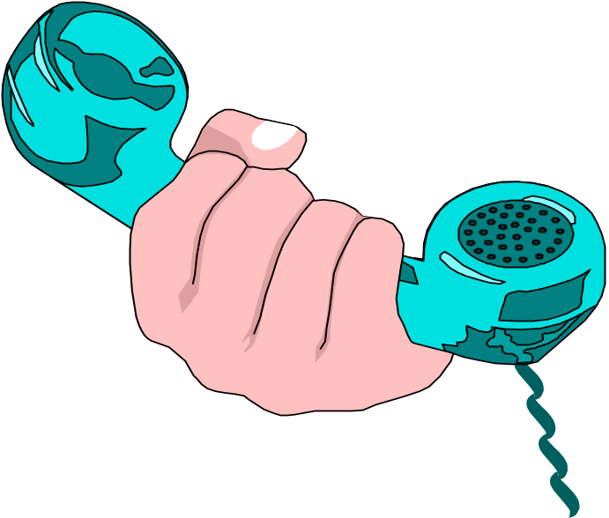
Hello Internet
// hello.java: Hello Internet program
class HelloInternet
{
public static void main(String args[])
{
System.out.println(“Hello Internet”);
}
}

Slide 36
Program Processing
Compilation
  # javac hello.java
  results in HelloInternet.class
Execution
  # java HelloInternet
  Hello Internet
  #

Slide 37
Anatomy of a Java Program
Comments
Reserved words
Modifiers
Statements
Blocks
Classes
Methods
The main method

Slide 38
Comments
Three types of comments in Java.
Line comment: A line comment is preceded by two slashes (//) in a line.
Paragraph comment: A paragraph comment is enclosed between /* and */ in one or multiple lines.
javadoc comment: javadoc comments begin with /* and end with */. They are used for documenting classes, data, and methods. They can be extracted into an HTML file using JDK's javadoc command.

Slide 39
Reserved Words
Reserved words or keywords are words that have a specific meaning to the compiler and cannot be used for other purposes in the program. For example, when the compiler sees the word class, it understands that the word after class is the name for the class. Other reserved words in are public, static, and void.

Slide 40
Modifiers
Java uses certain reserved words called modifiers that specify the properties of the data, methods, and classes and how they can be used. Examples of modifiers are public and static. Other modifiers are private, final, abstract, and protected. A public datum, method, or class can be accessed by other programs. A private datum or method cannot be accessed by other programs.

Slide 41
Statements
A statement represents an action or a sequence of actions. The statement System.out.println(“Hello Internet")
Every statement in Java ends with a semicolon (;).

Slide 42
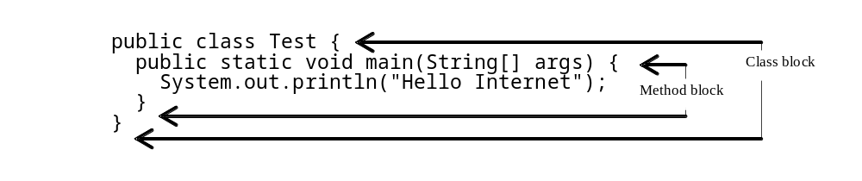
Blocks
A pair of braces in a program forms a block that groups components of a program.

Slide 43
Classes
The class is the essential Java construct.
A class is a template or blueprint for objects.
To program in Java, you must understand classes and be able to write and use them.

Slide 44
Methods
What is System.out.println? It is a method: a collection of statements that performs a sequence of operations to display a message on the console. It can be used even without fully understanding the details of how it works. It is used by invoking a statement with a string argument. The string argument is enclosed within parentheses. In this case, the argument is “Hello Internet" You can call the same println method with a different argument to print a different message.

Slide 45
main Method
The main method provides the control of program flow. The Java interpreter executes the application by invoking the main method.
The main method looks like this:
public static void main(String[] args) {
// Statements;
}

Slide 46
Simple Java Applet
//HelloWorld.java
import java.applet.Applet;
import java.awt.*;
public class HelloWorld extends Applet {
  public void paint(Graphics g) {
  g.drawString (“Hello World !”,25, 25);
  }
}

Slide 47
Calling an Applet
<HTML>
<TITLE>HELLO WORLD APPLET</TITLE>
<HEAD>THE HELLO WORLD APPLET</HEAD>
<APPLET CODE=“HelloWorld.class” width=500 height=500>
</APPLET>
</HTML>

Slide 48
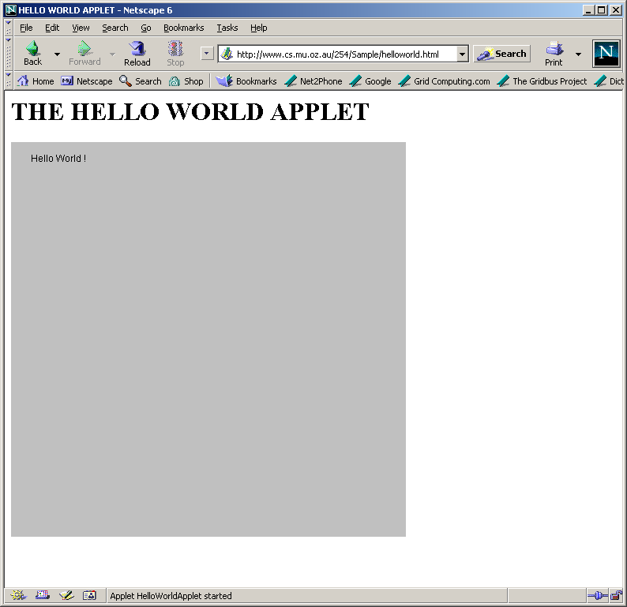
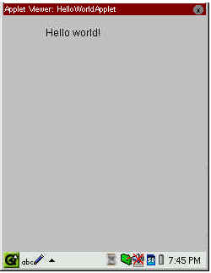
Applet Execution
Using AppletViewer
Using Browser

Slide 49
Java on my platform ?
Sun (SPARC) ftp://java.sun.com
Sun(x86) ftp://xm.com:/pub/
IBM(Aix, OS/2)ftp://ncc.hursley.ibm.com/javainfo
DEC(Alpha OSF/1) http://www.gr.osf.org:8001/projects/web/java/
SGI http://liawww.epfl.ch/~simon/java/irix-jdk.html
HP http://www.gr.osf.org:8001/projects/web/java
linux http://www.blackdown.org
AT & T http://www.gr.osf.org:8001/projects/web/java
Windows 3.1 http://www.alphaworks.ibm.com

Slide 50
Summary
Java has emerged as a general purpose OO language.
It supports both stand alone and Internet Applications.
Makes the Web Interactive and medium for application delivery.
Provides an excellent set of Tools for Application Development.
Java is ubiquitous!

Slide 51
References
Chapter 2: “Java Evolution”, Programming with Java by Balagurusamy, TMH, New Delhi, India
Optional:
  Chapter 1: “Mastering C++” by V. Rajuk and R. Buyya, Tata McGraw Hill, New Delhi, India.

